Slide 1

“AITor” EDUCATION PLATFORM A PERSONALIZED STUDENT PERFORMANCE ANALYZER AND RECOMMENDATION SYSTEM
2022-017

Slide 2
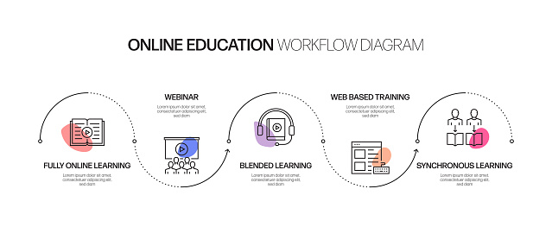
INTRODUCTION
What is E-Learning?
Why have we moved to E-Learning?

Slide 3
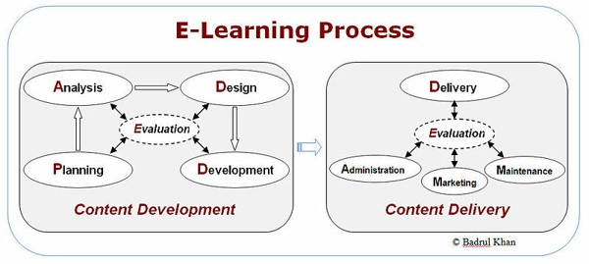
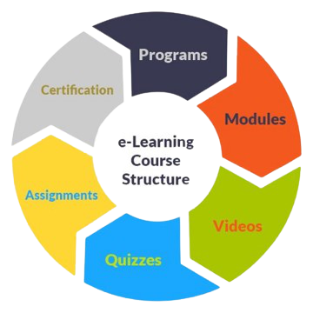
Source: https://en.wikibooks.org/wiki/File:E-learning_process_model.jpg
Source: https://medium.com/@nibtnashik/discover-e-learning-standards-its-advantages-950ec7b99980

Slide 4


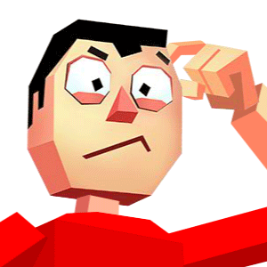

CAN YOU HEAR ME ????
I can’t do this!!!!!
TEACHERS
VS
STUDENTS
WTH is this??
Urrrrrghhh!!!

Slide 5
RESEARCH PROBLEM
Less Engagement
Fault justification of analysis
Human error
Improper balance in module content
Lack of human
resources

Slide 6
RESEARCH OBJECTIVE
All-In-One solution
Personalized learning experience
Provide detailed analysis of productivity (individual/overall)

Slide 7
Sub Objectives
Identify best learning strategy -> increase engagement
Identification and recommendation -> improved balance in course content
Performance analysis and personal skills identification -> Improved analysis from different aspects
Career recommendation and progress forecasting -> correct justification of analysis and reporting

Slide 8
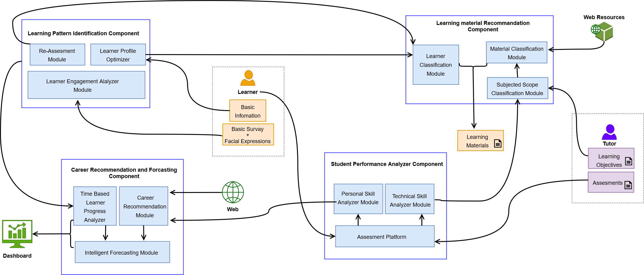
HIGH-LEVEL SYSTEM ARCHITECTURE

Slide 9
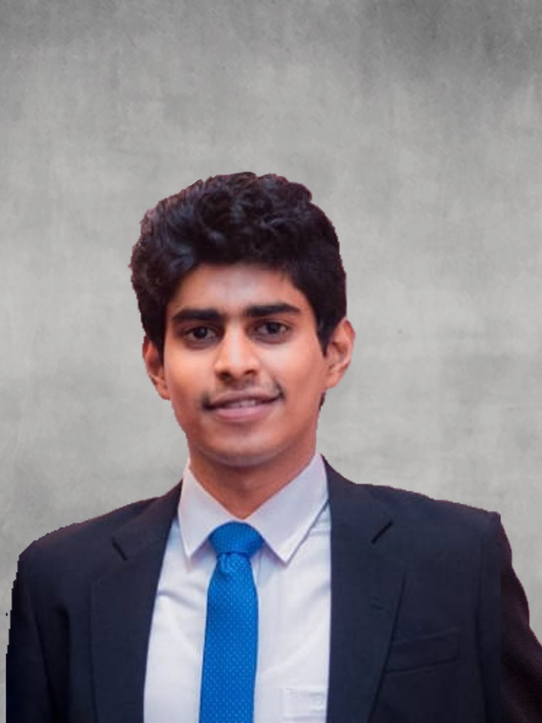
IT19120812 | LIYANAGE M.L.A.P.
Specialization: Software Engineering
IT19120812 | Liyanage M.L.A.P. | 2022-017

Slide 10
INTRODUCTION
Case study background – identification of best learning strategy/s
Research gap
Identified research problem
IT19120812 | Liyanage M.L.A.P. | 2022-017

Slide 11
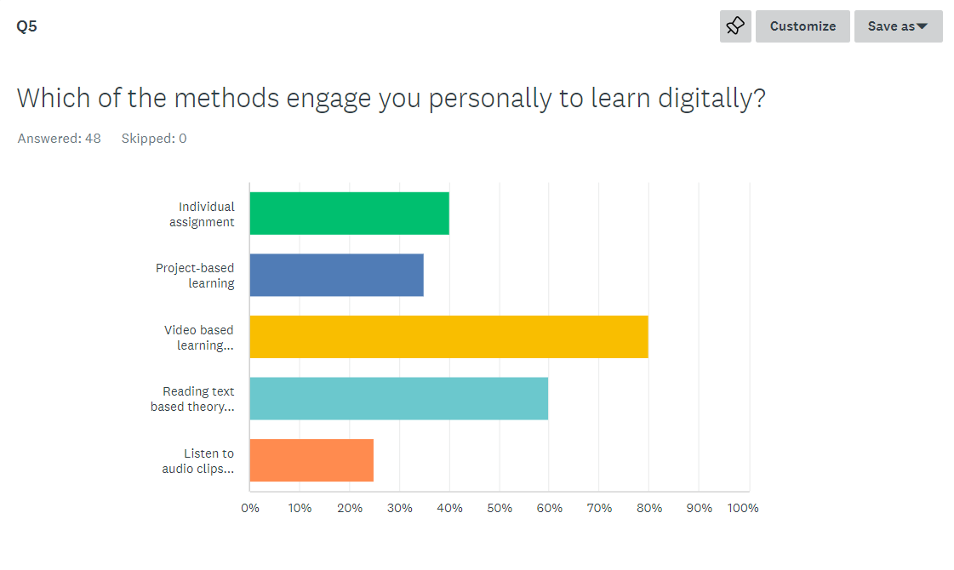
Background
What is meant by a learning strategy?
Classical and technology-enhanced learning strategies
Relationship between student engagement and learning strategy/s
IT19120812 | Liyanage M.L.A.P. | 2022-017
Notes:
Participants

Slide 12



Research Gap
Platform | Learning strategies |  |  | Personalized? | Engagement monitored?
 | Video | Text | Audio
Udemy [1] | Available | Available | Not-Available | NO | NO
Coursera [2] | Available | Available | Not-Available | NO | NO
Udacity | Available | Available | Not-Available | NO | NO
Research [4] | Available | Available | Not-Available | Not-AvailableNot-Available
AITor | Available | Available | Available | Yes | YES
IT19120812 | Liyanage M.L.A.P. | 2022-017

Slide 13
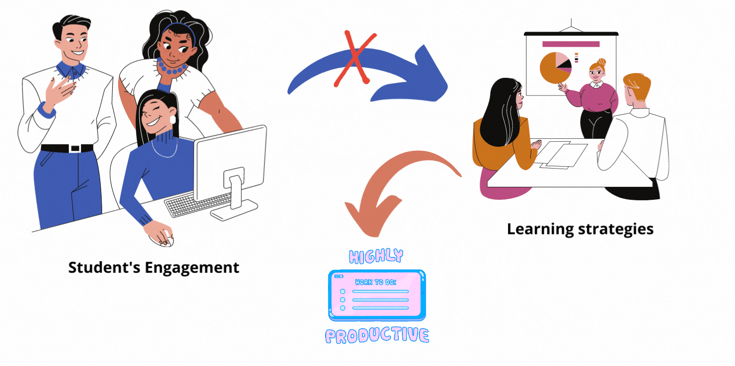
Identified Research Problem
How to achieve high productivity in online education by personalizing learning strategies to cope with student’s engagement?
IT19120812 | Liyanage M.L.A.P. | 2022-017

Slide 14
Research Objective
01
Learning strategy identification
Build up relationship between learning strategy and engagement
Building up a module to identify suited learning strategy out of
Video
Audio
Text for the student
Engagement analysis
Building up a module that monitor and provide detailed analysis of student engagement
02

Slide 15
STEPS WE ARE FOLLOWING
TOOLS & TECHNOLOGIES
WORK SCHEDULE
01
03
02
04
SYSTEM DIAGRAM
REQUIRMENTS
IT19120812 | Liyanage M.L.A.P. | 2022-017

Slide 16
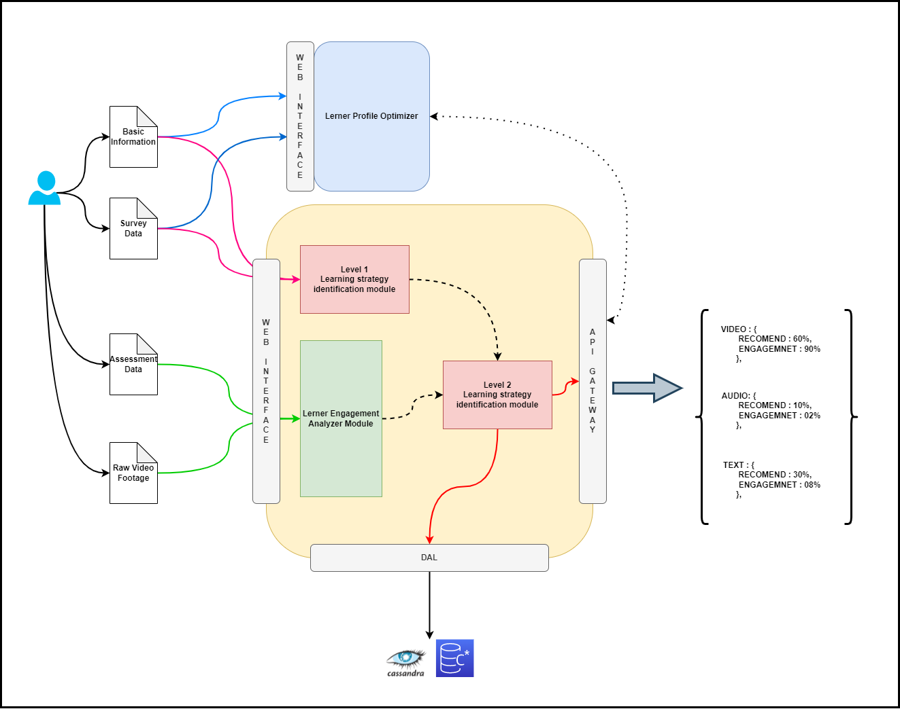
System Diagram
IT19120812 | Liyanage M.L.A.P. | 2022-017

Slide 17













Tools and Technologies
Programming Languages | Frames and Libraries | Cloud Technologies And Databases | DevOps/Other
IT19120812 | Liyanage M.L.A.P. | 2022-017

Slide 18
Requirements
User Requirements | System Requirements
 | Functional Requirements | Non-Functional Requirements
 | Identify the learning strategy of the student | Scalability
 | Identify the pattern of engagement of the student | Availability
 | Generate report of overall student engagement in a class/batch | Accuracy
 | Re-evaluate/ re-asses identified learning strategy upon identification of low engagement | High privacy
As a student, I want to access my course content so that I can learn something new
As a Tutor, I want to know whether my students are engaging in course content so that I can assure productive delivery of content
As a student/tutor, I want to access the application via Web from anywhere so that I won't find it difficult to access
As a student I want a personalized learning profile so that I can track my learnings
IT19120812 | Liyanage M.L.A.P. | 2022-017

Slide 19
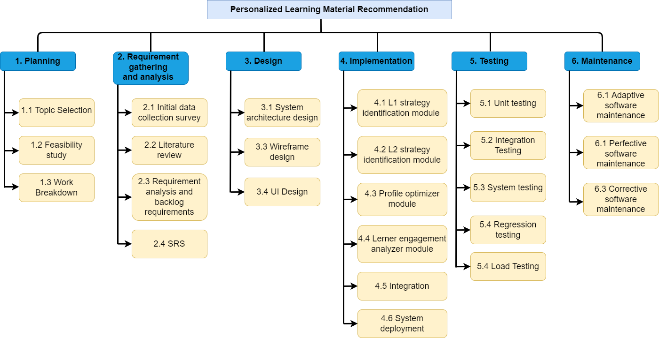
Work Breakdown Structure
IT19120812 | Liyanage M.L.A.P. | 2022-017

Slide 20
Work Schedule
IT19120812 | Liyanage M.L.A.P. | 2022-017

Slide 21
References
[1] “Research,” Udemy Research, 16-Oct-2017. [Online]. Available: https://research.udemy.com/research-reports/. [Accessed: 01-Feb-2022].
[2] Coursera, “Coursera's mission, vision, and commitment to our community,” Coursera. [Online]. Available: https://about.coursera.org/. [Accessed: 01-Feb-2022].
[3] P. D. Barua, X. Zhou, R. Gururajan, and K. C. Chan, “Determination of Factors Influencing Student Engagement Using a Learning Management System in a Tertiary Setting,” in 2018 IEEE/WIC/ACM International Conference on Web Intelligence (WI), Dec. 2018, pp. 604–609. doi: 10.1109/WI.2018.00-30.
[4] A. Dwivedi, P. Dwivedi, S. Bobek, and S. Sternad Zabukovšek, “Factors affecting students’ engagement with online content in blended learning,” Kybernetes, vol. 48, no. 7, pp. 1500–1515, Jan. 2019, doi: 10.1108/K-10-2018-0559.
IT19120812 | Liyanage M.L.A.P. | 2022-017

Slide 22

IT19120362 | THAMMITA D.H.M.M.P
Specialization: Software Engineering
IT19120362 | Thammita D.H.M.M.P. | 2022-017

Slide 23
INTRODUCTION
Background
Research gap
Identified research problem
IT19120362 | Thammita D.H.M.M.P. | 2022-017

Slide 24
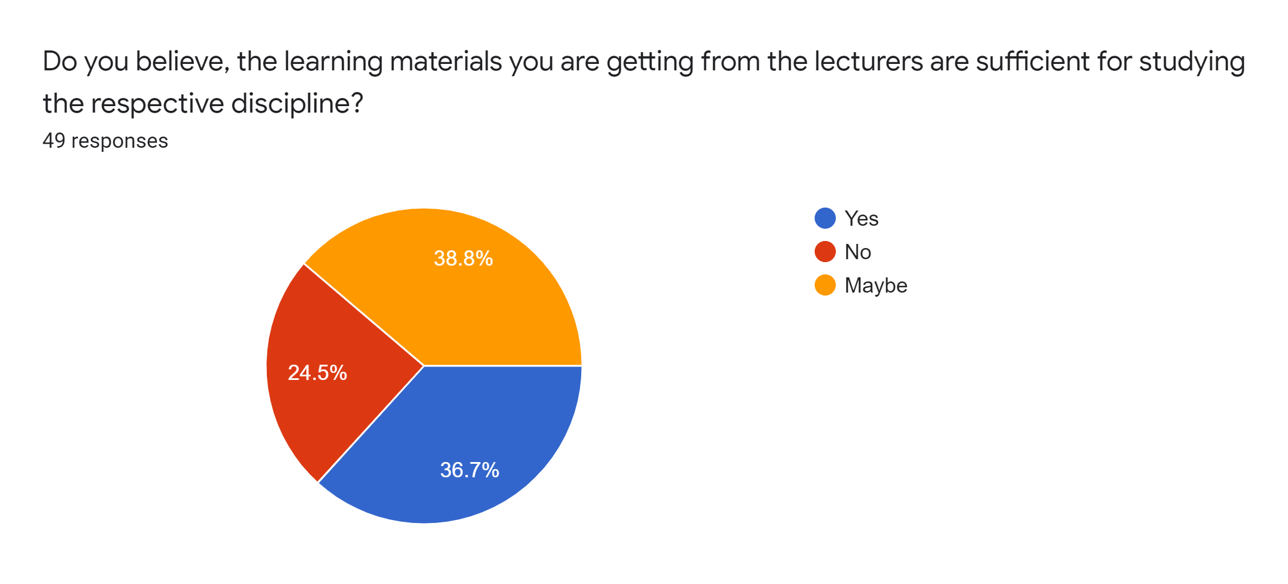
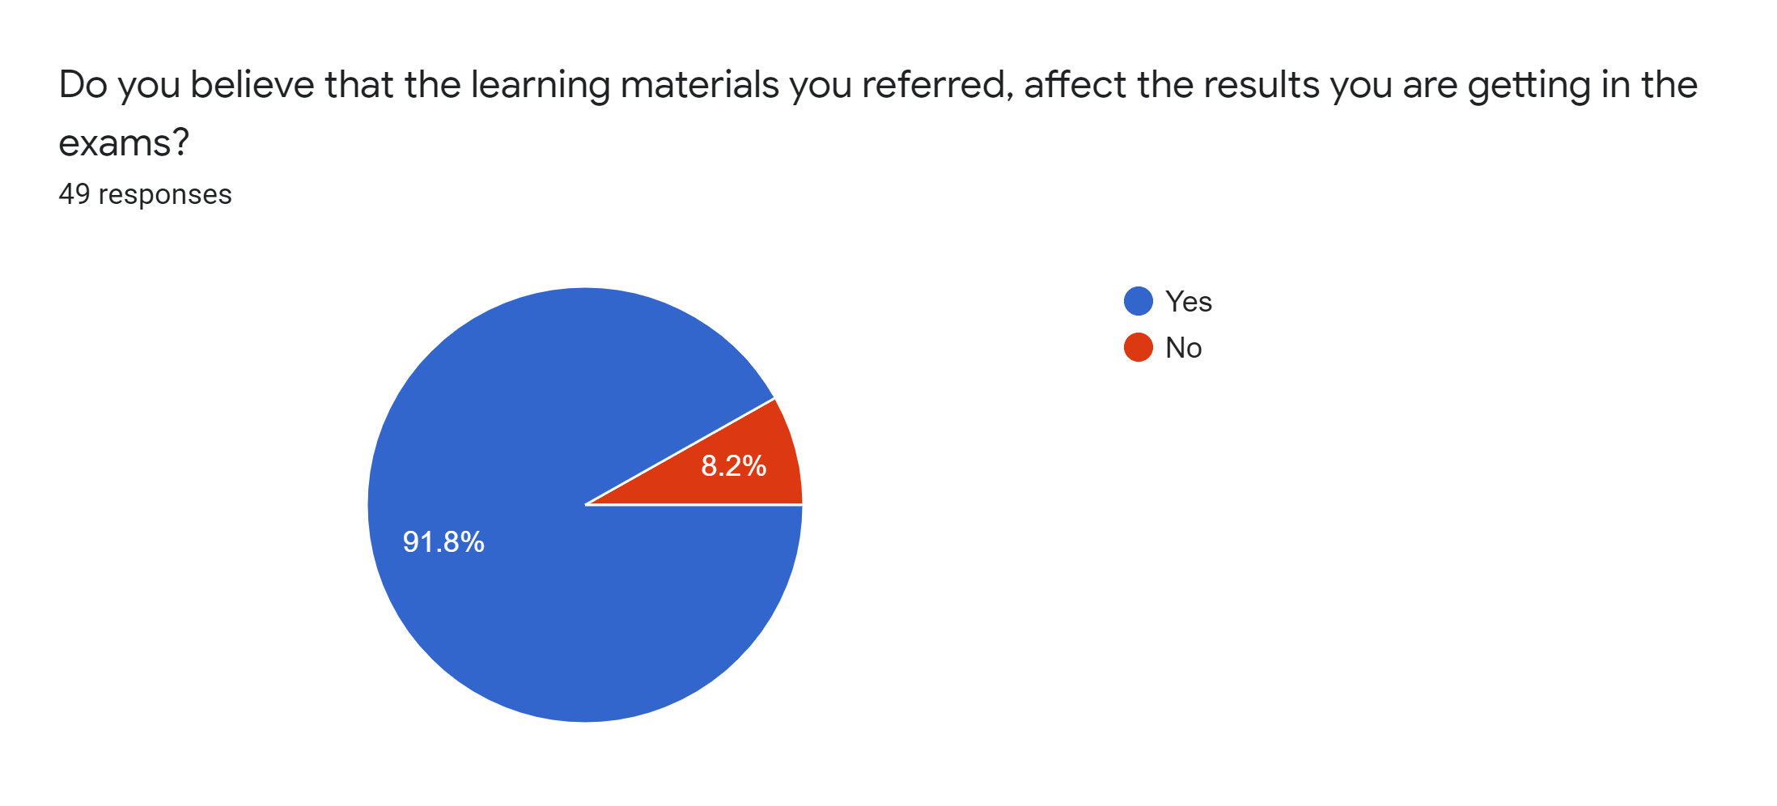
Background
Why Learning Material Recommendation?
Why should learning material recommendation personalized ?
What to consider on learning material recommendation?
IT19120362 | Thammita D.H.M.M.P. | 2022-017

Slide 25
Research gap
Platform | Facts to consider in material recommendation
 | Explicit Attributes |  | Implicit Attributes
 | Materials | Learner | Materials | Learner
 |  |  |  | Behavior(Access pattern) | Problem Based Learning | Knowledge Gaps | Learning Strategy
TjLRSE[4] | ✓ | ✓ | ✗ | ✓ | ✓ | ✗ | ✗
Research 2 [1] | ✓ | ✓ | ✓ | ✓ | ✗ | ✗ | ✗
Research 3 [2] | ✓ | ✓ | ✓ | ✓ | ✗ | ✗ | ✗
AITor | ✓ | ✓ | ✓ | ✓ | ✓ | ✓ | ✓
IT19120362 | Thammita D.H.M.M.P. | 2022-017

Slide 26



Identified research problem
I can’t understand?
How to personalize learning material recommendations based on personal learning patterns and strategies?
Why have I failed?
What have I missed?
How to improve the productivity of the learning process by identifying knowledge gaps of learners?
IT19120362 | Thammita D.H.M.M.P. | 2022-017

Slide 27
STEPS WE ARE FOLLOWING
TOOLS & TECHNOLOGIES
WORK SCHEDULE
01
03
02
04
SYSTEM DIAGRAM
REQUIRMENTS
IT19120362 | Thammita D.H.M.M.P. | 2022-017

Slide 28
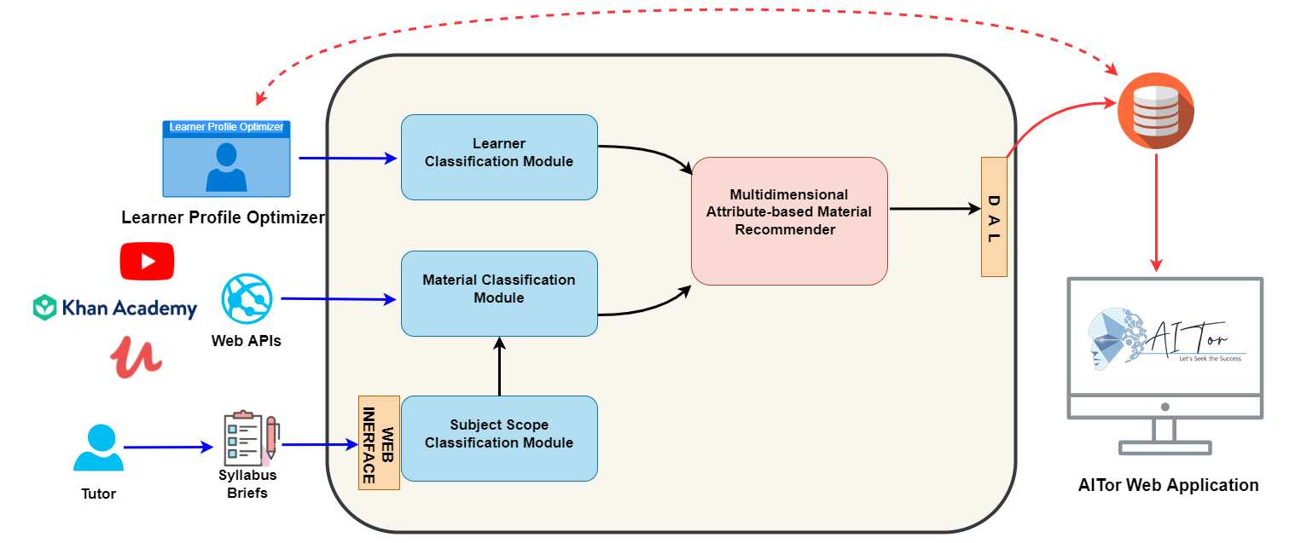
System Diagram
IT19120362 | Thammita D.H.M.M.P. | 2022-017

Slide 29

Research Objectives
Main Objective
Support for the Improvement of the productivity of the learning process through an automated learning material recommendation mechanism based on learning patterns, learning strategies, and knowledge gaps of learners.
IT19120362 | Thammita D.H.M.M.P. | 2022-017

Slide 30
Sub Objectives
Building up a material classification approach based on their implicit and explicit attributes.
Building up a learner classification approach based on their learning patterns, learning strategies, and knowledge gaps.
Implement a learning material recommendation mechanism based on personalized attributes of learners and learning materials
IT19120362 | Thammita D.H.M.M.P. | 2022-017

Slide 31




Tools and Technologies
Programming Languages | Frameworks and Libraries | Cloud Technologies and Database | Other
IT19120362 | Thammita D.H.M.M.P. | 2022-017

Slide 32
Requirements
User Requirements | System Requirements
 | Functional Requirements | Non-Functional Requirements
 | Identify subject scope using syllabus briefs | Accuracy
 | Recommend learning materials that aligns with learners learning stratagy | Availability
 | Recommend learning materials based on learners' weak areas | Scalability
 | Implement a platform which learners can access all learning materials through one place
As a student, I need to access learning materials through the LMS so that I can study through a same platform
As a tutor, I need to upload syllabus briefs of subjects into the online learning platform so that I students can refer the learning materials according to the expected learning objectives
As a student, I need get learning materials that suit with my learning pattern so that I can understand them more easily
As a student, I need to refer more learning materials in my weak areas so that I can improve my skills my weak areas
IT19120362 | Thammita D.H.M.M.P. | 2022-017

Slide 33
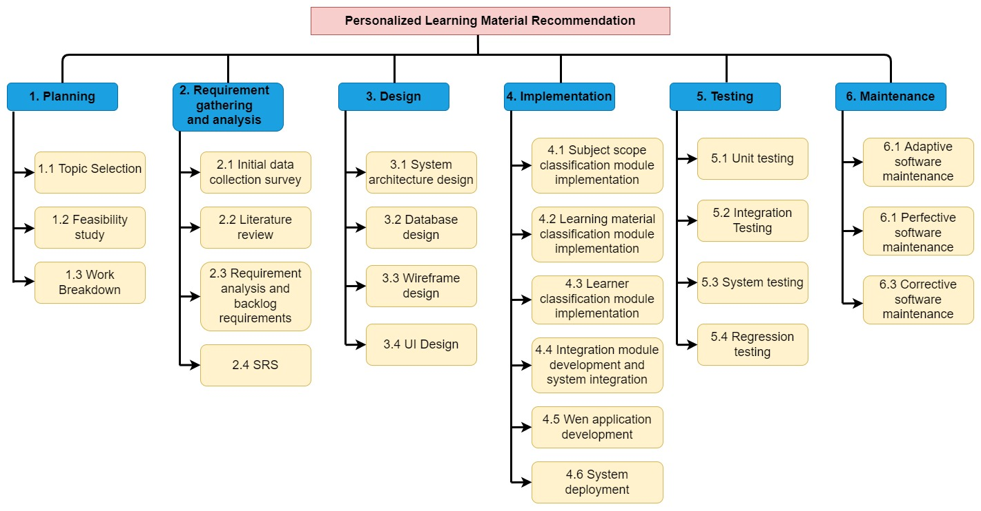
Work breakdown structure
IT19120362 | Thammita D.H.M.M.P. | 2022-017

Slide 34
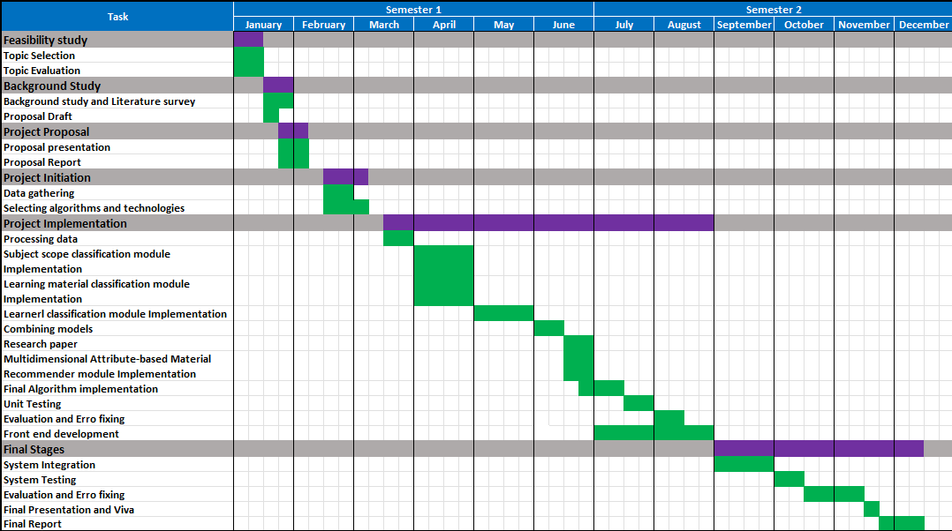
Work Schedule
IT19120362 | Thammita D.H.M.M.P. | 2022-017

Slide 35
References
[1] M. Salehi, I. N. Kmalabadi, and M. B. G. Ghoushchi, “A New Recommendation Approach Based on Implicit Attributes of Learning Material,” IERI Procedia, vol. 2, pp. 571–576, 2012, doi: 10.1016/j.ieri.2012.06.136.
[2] M. Salehi, I. Nakhai Kamalabadi, and M. B. Ghaznavi Ghoushchi, “Personalized recommendation of learning material using sequential pattern mining and attribute based collaborative filtering,” Educ Inf Technol, vol. 19, no. 4, pp. 713–735, Dec. 2014, doi: 10.1007/s10639-012-9245-5.
[3] “An association rule based recommender system for learning materials recommendation.” https://vpn.sliit.lk/proxy/11ea7a12/https/ieeexplore.ieee.org/document/9470635 (accessed Jan. 04, 2022).
[4] F.-J. Liu, “Design of Self-Directed E-Learning Material Recommendation System with On-Line Evaluation,” in 2008 International Conference on Convergence and Hybrid Information Technology, Daejon, South Korea, 2008, pp. 274–277. doi: 10.1109/ICHIT.2008.184.
IT19120362 | Thammita D.H.M.M.P. | 2022-017

Slide 36

IT19138114 | HIRIMUTHUGODA U.J
Specialization: Software Engineering
IT19138114 | Hirimuthugoda U.J | 2022-017

Slide 37
INTRODUCTION
Case study background
Research gap
Identified research problem
IT19138114 | Hirimuthugoda U.J. | 2022-017

Slide 38
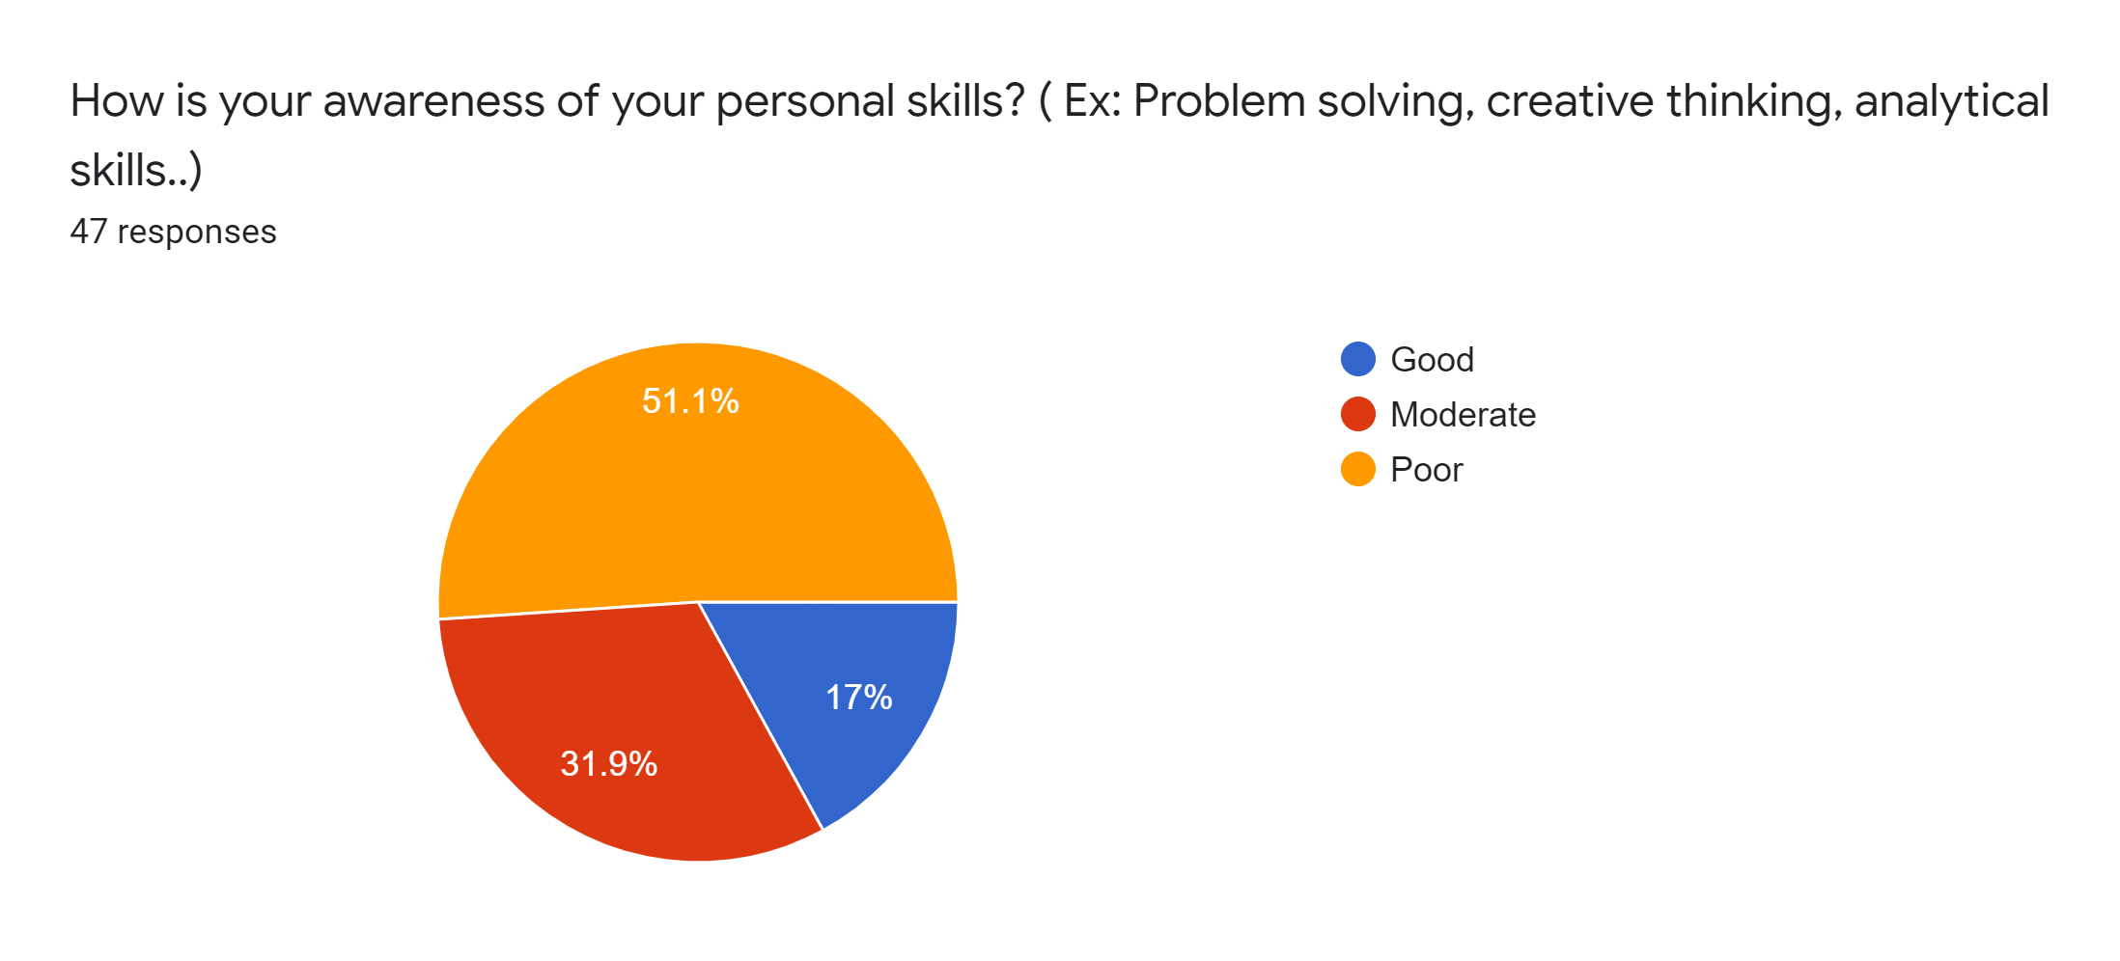
Background
What is student performance analysis and what are the things to consider?
Why personal skills are important?
Capabilities of existing systems to do an accurate performance analysis
IT19138114 | Hirimuthugoda U.J. | 2022-017

Slide 39
Research gap
Research | Performance evaluation |  | Weak learning areas identification | Additionally considered factors in performance analysis (Through assessments)
Platform | Subject knowladge | Personal skills |  | Concept of the question | Spent Time | Difficulty level | Answering confidence
Research A [1] | ✓ | ✗ | ✗ | ✓ | ✓ | ✓ | ✓
Research B [2] | ✓ | ✗ | ✗ | ✗ | ✓ | ✓ | ✗
Research C [3] | ✓ | ✗ | ✗ | ✓ | ✗ | ✓ | ✗
AITor | ✓ | ✓ | ✓ | ✓ | ✓ | ✓ | ✓
IT19138114 | Hirimuthugoda U.J | 2022-017

Slide 40

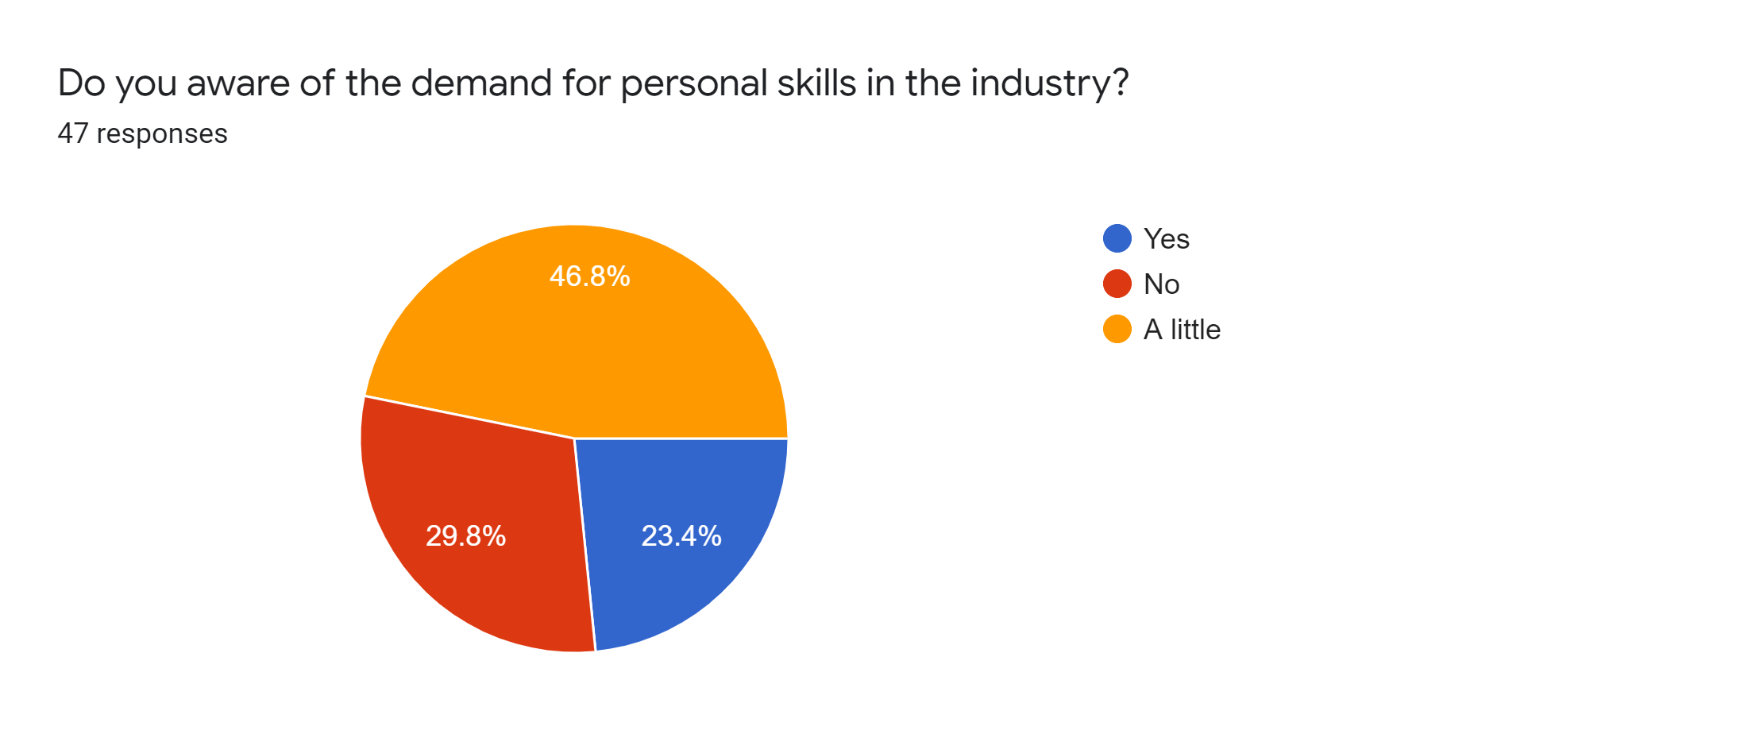
Identified research problem
IT
Students can’t get accurate performance analysis in existing learning platforms
SE
IM
Existing learning platforms focus on student’s technical skills only.
Which path should I choose?
Inaccurate performance analysis may lead to wrong academic and career decisions.
IT19138114 | Hirimuthugoda U.J | 2022-017

Slide 41
STEPS WE ARE FOLLOWING
TOOLS & TECHNOLOGIES
WORK SCHEDULE
01
03
02
04
SYSTEM DIAGRAM
REQUIRMENTS
IT19138114 | Hirimuthugoda U.J | 2022-017

Slide 42
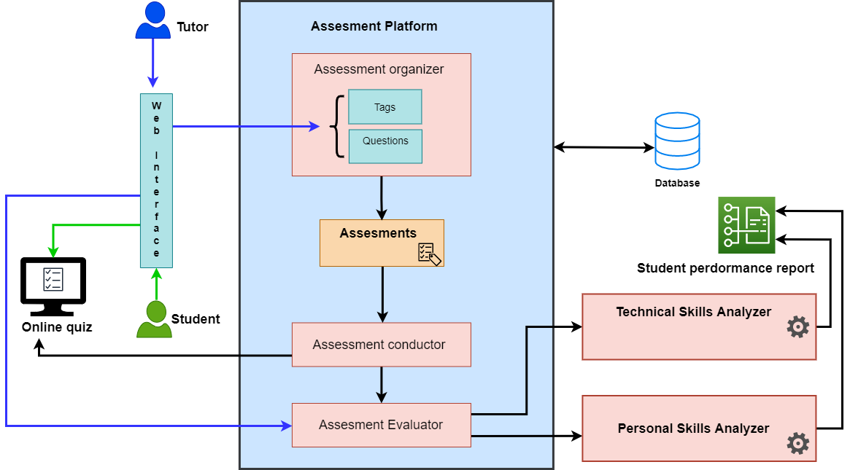
System Diagram
IT19138114 | Hirimuthugoda U.J | 2022-017

Slide 43

Tools and Technologies
Programming Languages | Frameworks and Libraries | Cloud Technologies | Databases | DevOps/Other
IT19138114 | Hirimuthugoda U.J | 2022-017

Slide 44
Research Objectives
Main Objective
Provide a detailed student performance analysis
Prepare and conduct assessment
Identify weak module areas
Analyze subject based knowledge
Identify measurable personal skills level
Answering Speed
Confidence of answering
IT19138114 | Hirimuthugoda U.J | 2022-017

Slide 45
Requirements
Functional Requirement
Conduct assessments for completed module areas
Collect student confidence of answering, answering speed and content covering speed
Identify student’s weak module areas
Identify student personal skills
Evaluate assessment to analyze subject knowledge
User Requirement
Tutor can Prepare and conduct assessments for completed module areas
Student can attend to assessments
Student and Tutor can see student’s performance report
Non - Functional Requirement
Accuracy
Usability
Privacy
Reliability
IT19138114 | Hirimuthugoda U.J | 2022-017

Slide 46
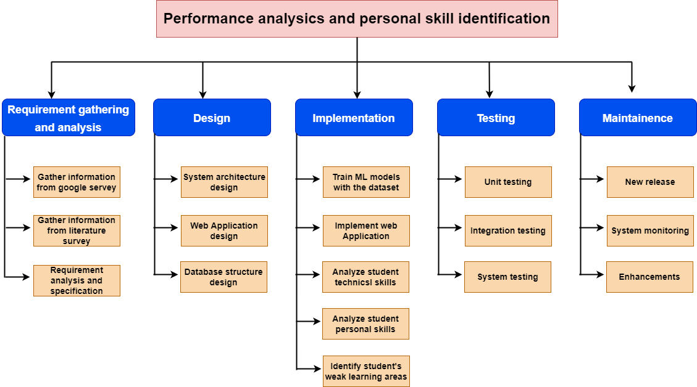
Work breakdown structure
IT19138114 | Hirimuthugoda U.J | 2022-017

Slide 47
Work Schedule
IT19138114 | Hirimuthugoda U.J | 2022-017

Slide 48
References
[1] A. Sharma, “A proposed e-learning system facilitating recommendation using content tagging and student learning styles,” in 2017 5th National Conference on E-Learning & E-Learning Technologies (ELELTECH), Hyderabad, India, Aug. 2017, pp. 1–6. doi: 10.1109/ELELTECH.2017.8074989.
[2] K. Khan, J. Patil, N. Shaikh, A. Thakur, and Z. Pirani, “Analysis of Intelligent System for Student’s Performance using E-learning Approach,” in 2018 International Conference on Smart Systems and Inventive Technology (ICSSIT), Tirunelveli, India, Dec. 2018, pp. 390–394. doi: 10.1109/ICSSIT.2018.8748328.
[3] “Abidi and Goh - 2001 - A Web-enabled Exam Preparation and Evaluation Serv.pdf.” Accessed: Feb. 01, 2022.
IT19138114 | Hirimuthugoda U.J | 2022-017

Slide 49

IT19188546 | LIYANAGE N.L.T.N.
Specialization: Software Engineering
IT19188546 | Liyanage N.L.T.N. | 2022-017

Slide 50
INTRODUCTION
Case study background / Analyze, Forecast
Research gap
Identified research problem
IT19188546 | Liyanage N.L.T.N. | 2022-017

Slide 51
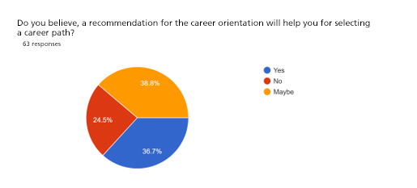
Background
What to analyze?
Forecast of the performance analysis
Struggle to select the career orientation
Progress of the student
Visualized Dashboard
A Career Recommendation
IT19188546 | Liyanage N.L.T.N. | 2022-017

Slide 52
Research gap
Platform / Tool | Time Based Learner Analyzer | Progress analyzer | Forecast Dashboard |  | Career Recommendation
 | Result Analysis | Progress Analysis | Overall | Individual
Blackboard | ✓ | ✗ | ✓ | ✗ | ✗
Jotform | ✗ | ✓ | ✗ | ✗ | ✗
Research [3] | ✗ | ✗ | ✓ | ✗ | ✗
AITor | ✓ | ✓ | ✓ | ✓ | ✓
IT19188546 | Liyanage N.L.T.N. | 2022-017

Slide 53


Identified research problem
How to obtain more productivity by analyzing and forecasting the progress of the students?
(Individual/Overall)
What are the possible steps to reduce the struggle of the students when they are about to select their career orientation?
IT19188546 | Liyanage N.L.T.N. | 2022-017

Slide 54
Research Objectives
Main Objective
Conduct a detailed student progress analysis, forecasting and provide a career recommendation.
Conduct a progress analysis for the student performance.
Conduct a time series forecasting based on the student performance.
Present a detailed dashboard in the both individual and overall manner.
Identify the best suited career orientation for the student .
IT19188546 | Liyanage N.L.T.N. | 2022-017

Slide 55
STEPS WE ARE FOLLOWING
TOOLS & TECHNOLOGIES
WORK SCHEDULE
01
03
02
04
SYSTEM DIAGRAM
REQUIRMENTS
IT19188546 | Liyanage N.L.T.N. | 2022-017

Slide 56
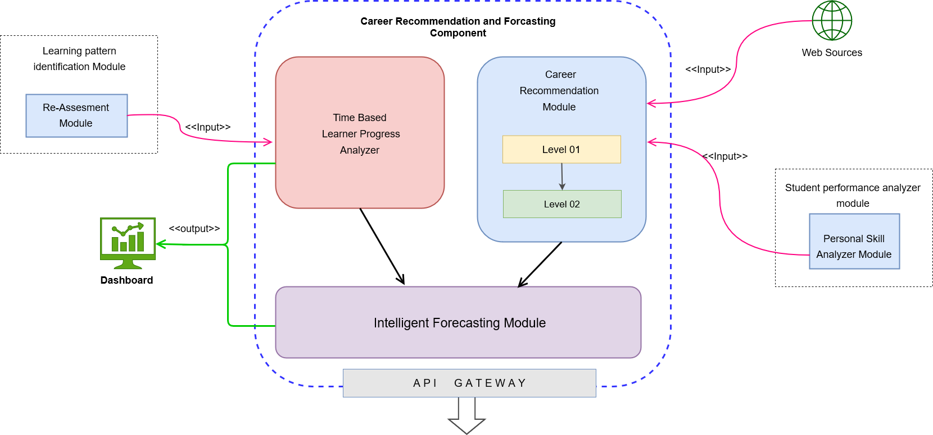
System Diagram
IT19188546 | Liyanage N.L.T.N. | 2022-017

Slide 57


Tools and Technologies
Programming Languages | Frames and Libraries | Cloud Technologies | Other Services
IT19188546 | Liyanage N.L.T.N. | 2022-017

Slide 58
Requirements
User Requirements | System Requirements
 | Functional Requirements | Non-Functional Requirements
 | Identify the progressed points of the students. | Accuracy
 | Conduct a time series forecasting for the student performance. | Availability
 | Generate a fully functional dashboard for present the analyzed data. | Usability
 | Recommend a career orientation based on the performance and other factors.
As an institution, we want to see students’ progress so that we can adjust our course content to it
As a student, I want to go through my course content so that I know where should I pat more attention.
As a student, I want to get a recommendation for my career orientation so that it would be easy for apply jobs.
IT19188546 | Liyanage N.L.T.N. | 2022-017

Slide 59
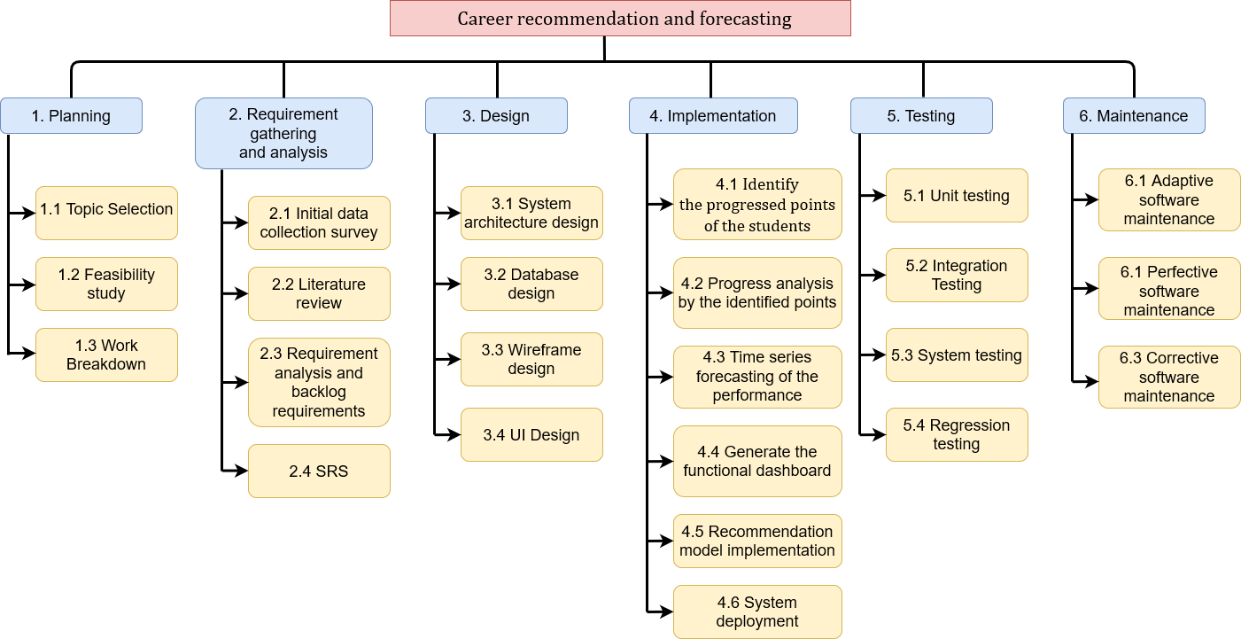
Work breakdown structure
IT19188546 | Liyanage N.L.T.N. | 2022-017

Slide 60
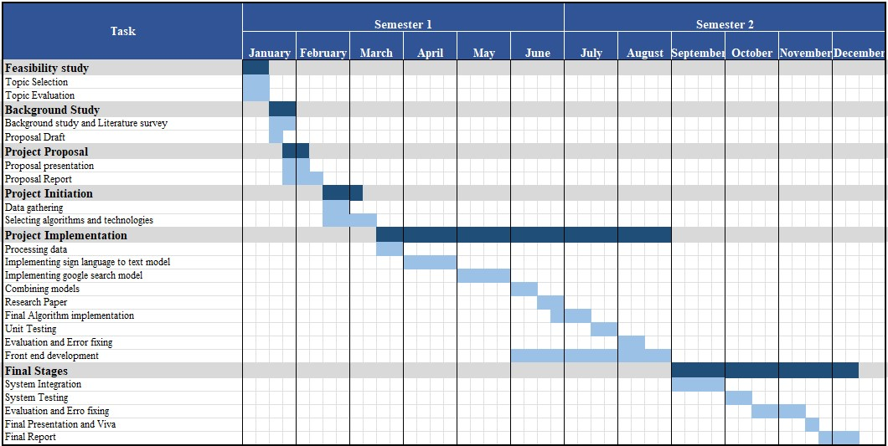
Work Schedule
IT19188546 | Liyanage N.L.T.N. | 2022-017

Slide 61
References
[1] P. Akosah-Twumasi, T. I. Emeto, D. Lindsay, K. Tsey, and B. S. Malau-Aduli, “A Systematic Review of Factors That Influence Youths Career Choices—the Role of Culture,” Frontiers in Education, vol. 3, 2018, Accessed: Jan. 23, 2022. [Online]. Available: https://www.frontiersin.org/article/10.3389/feduc.2018.00058
[2] A. I. Harrouk and A. M. Barbar, “A Psycholinguistic Approach to Career Selection Using NLP with Deep Neural Network Classifiers,” in 2018 IEEE International Multidisciplinary Conference on Engineering Technology (IMCET), Beirut, Nov. 2018, pp. 1–6. doi: 10.1109/IMCET.2018.8603068.
[3] I. Singh, A. S. Sabitha, and A. Bansal, “Student performance analysis using clustering algorithm,” in 2016 6th International Conference - Cloud System and Big Data Engineering (Confluence), Noida, India, Jan. 2016, pp. 294–299. doi: 10.1109/CONFLUENCE.2016.7508131.
IT19188546 | Liyanage N.L.T.N. | 2022-017

Slide 62

We built the product.. But what's NEXT?

Slide 63


COMMERCIALIZATION
What we offer?
1 Month Free Trial
Paid Version
Free Version
With all functionalities of the system
With all functionalities of the system
24/7 Service
With limited functionalities of the system
Notes:
Free/paid – features

Slide 64

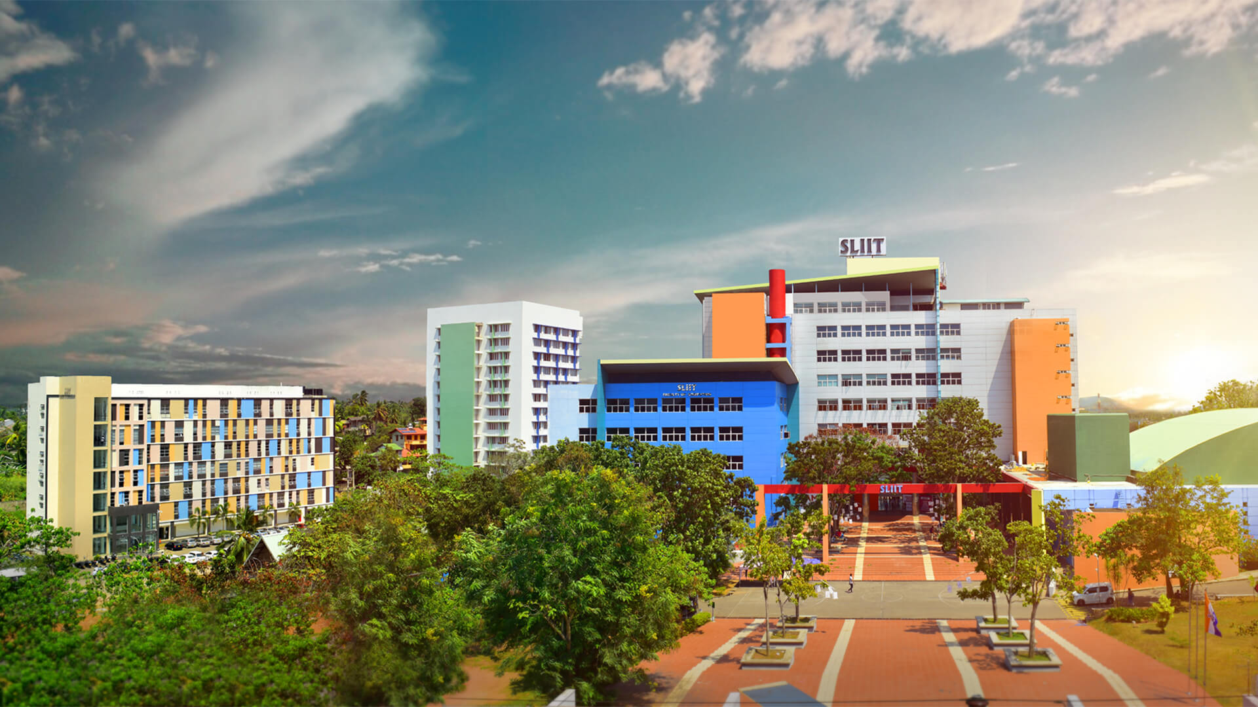
COMMERCIALIZATION
Who are we focused on?
Higher Educational Institutes
Schools
Who Will be benefitted?
Students(School/undergraduates)
Teachers
Education institute management
Notes:
Free/paid – features

Slide 65

COMMERCIALIZATION
What strategies we follow?
Customer success marketing
Free training
Well documented documentation
24/7 online customer service
Promotions
Personal Selling
Notes:
Free/paid – features

Slide 66

BUDGET
Resource Type | Amount(USD)
Cloud Expenses | 35$
Third party integrations and APIs | 30$
Domain name registration | 20$
Stationary | 5$
Other | 5$
Total | 95$

Slide 67
Thank You!
From Team,
- 2022-017 -

